Slide 1
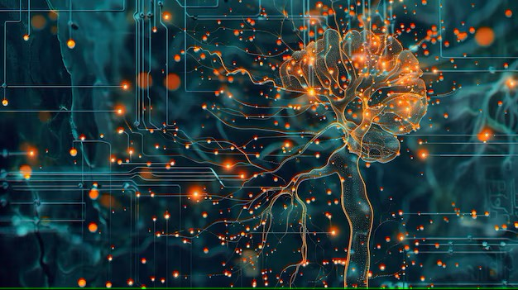



Extra Session (Discussion)
11th Apr, 2025
Deep Learning
Prof. Sudarshan Iyenger
Professor and Head of the Department
Department of Computer Science and Engineering
IIT Ropar
Ayan Paul
PMRF Research Scholar
IIT Kharagpur

Slide 2
Topics on which Week 1 Assignment Questions are based
Deep Learning Timeline
McCulloch Pitts Neuron
Perceptron
Perceptron Learning Algorithm

Slide 3
Topics on which Week 2 Assignment Questions are based
Network of Perceptrons
Sigmoid Neuron
Gradient Descent
Universal Approximation Theorem

Slide 4
Topics on which Week 3 Assignment Questions are based
Feedforward Neural Networks
Learning Parameters
Choice of Activation function at different layers
Choice of Loss function
Back-Propagation

Slide 5
Topics on which Week 4 Assignment Questions are based
Gradient Descent
Momentum based Gradient Descent
Nesterov Accelerated Gradient Descent
Stochastic and Mini-Batch Gradient Descent
Adaptive Gradient, Root Mean Square Propagation and Adaptive Moment Estimation

Slide 6
Topics on which Week 5 Assignment Questions are based
Eigenvectors and Eigenvalues
Linear Algebra (linearly independent basis)
Principal Component Analysis
Eigenvalue Decomposition
Singular Value Decomposition

Slide 7
Topics on which Week 6 Assignment Questions are based
Autoencoders
Undercomplete and Overcomplete Autoencoders
Link between Autoencoders and PCA
Denoising Autoencoders
Sparse Autoencoders
Contractive Autoencoders

Slide 8
Topics on which Week 7 Assignment Questions are based
Bias and Variance
Train and Test Error
True Error and Model Complexity
Different types of Regularization

Slide 9
Topics on which Week 8 Assignment Questions are based
Training Deep Neural Network
Unsupervised Pre-Training
Better Activation Functions
Better Initialization Strategies
Batch Normalization

Slide 10
Topics on which Week 9 Assignment Questions are based
One-hot representations of words
Distributed Representation of words
SVD for learning Word Representation
Word2vec (CBOW and Skip-gram)
GloVe Representation
Count Based vs. Prediction Based Models

Slide 11
Topics on which Week 10 Assignment Questions are based
Convolution Operation
Relation between input size, output size and filter size
Convolutional Neural Networks (CNN)
Training CNN
CNNs (success stories on ImageNet)
Visualizing Convolutional Neural Networks

Slide 12
Topics on which Week 11 Assignment Questions are based
Sequence Learning Problems
Recurrent Neural Networks
Backpropagation through time
Selective Read, Selective Write, Selective Forget—The Whiteboard Analogy
Long Short Term Memory (LSTM) and Gated Recurrent Units (GRUs)

Slide 13
Topics on which Week 12 Assignment Questions are based
Introduction to Encoder Decoder Models
Applications of Encoder Decoder Models
Attention Mechanism
Attention over images
Hierarchical RNN
Attention in Hierarchical RNNs

Slide 14
QUESTION 1
Which of the following statements best describes the difference between McCulloch-Pitts neurons and the perceptron model?
McCulloch-Pitts neurons introduced numerical weights for inputs, while the perceptron model did not.
McCulloch-Pitts neurons allowed inputs to be any numerical value, while the perceptron model only used Boolean values.
The perceptron model introduced numerical weights for inputs and a mechanism for learning these weights, while McCulloch-Pitts neurons did not.
The perceptron model was developed before McCulloch-Pitts neurons by Minsky and Papert.
SOLUTION 1
The perceptron model introduced numerical weights for inputs and a mechanism for learning these weights, while McCulloch-Pitts neurons did not.
CORRECT ANSWER 1
c)

Slide 15

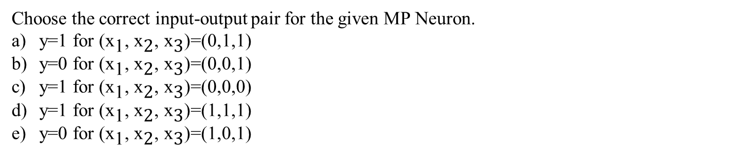
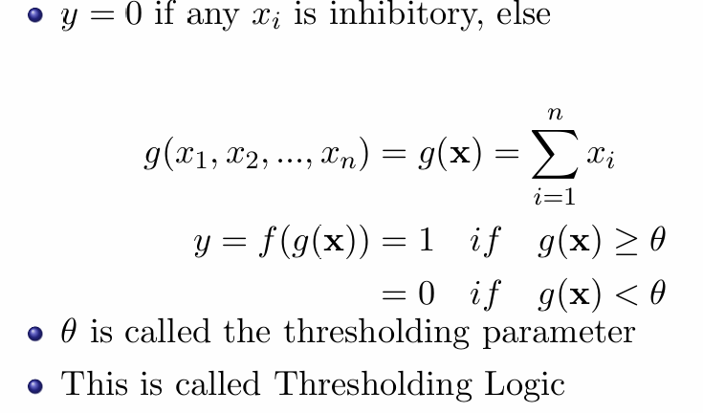
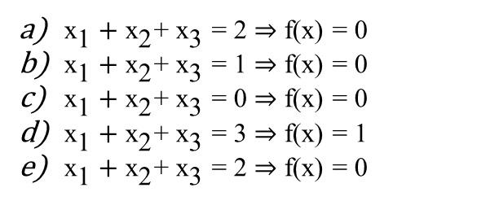
QUESTION 2
SOLUTION 2
CORRECT ANSWER 2
b), d), e)

Slide 16
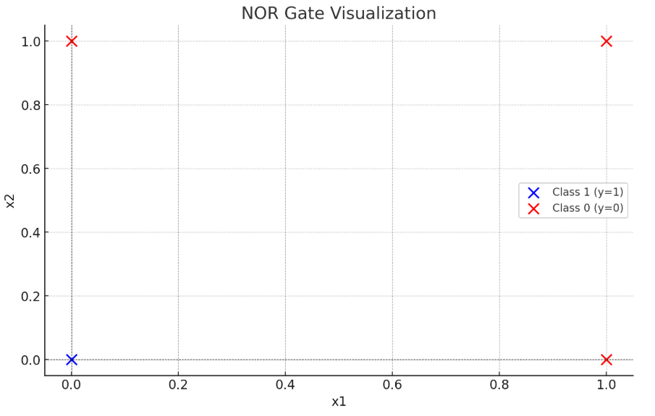
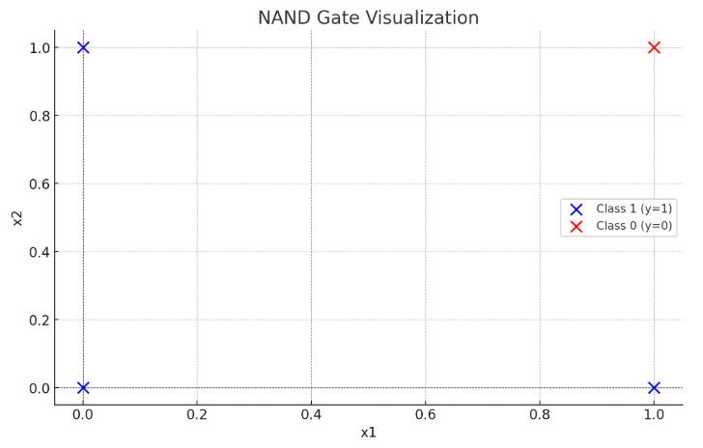
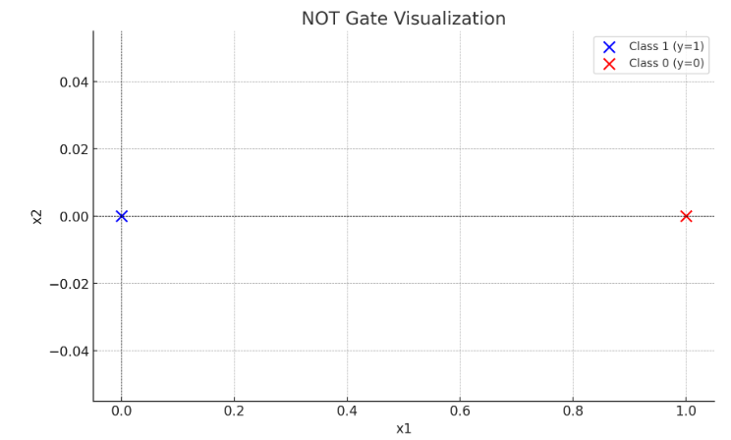
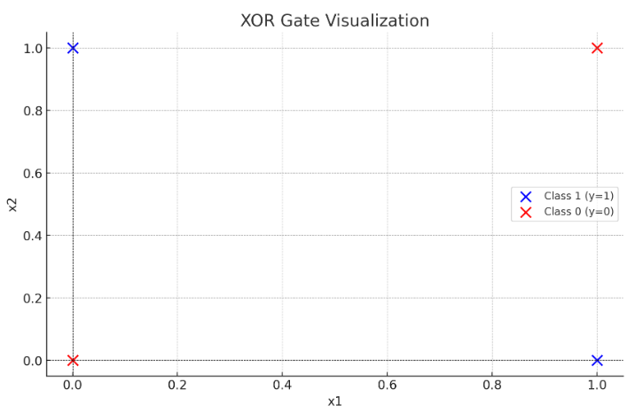
QUESTION 3
Which of the following Boolean functions can be implemented using a perceptron?
NOR
NAND
NOT
XOR
SOLUTION 3
As data for NOR, NAND and NOT are linearly separable, perceptron can be implemented
CORRECT ANSWER 3
a), b), c)

Slide 17
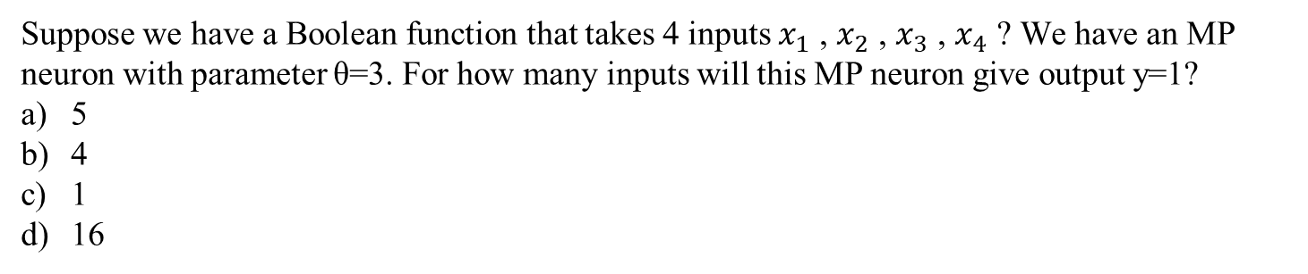

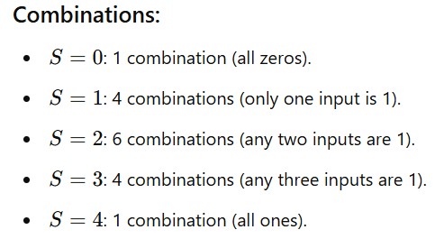
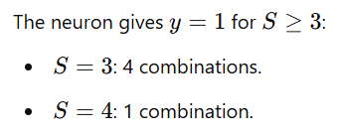
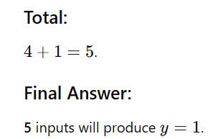
QUESTION 4
SOLUTION 4
CORRECT ANSWER 4
a)

Slide 18
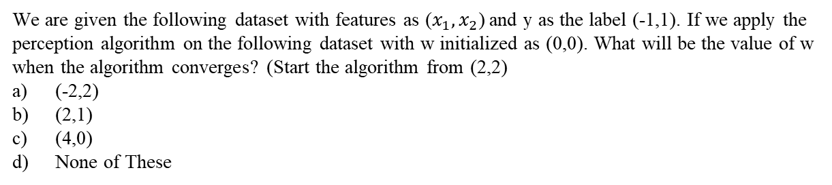
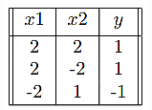
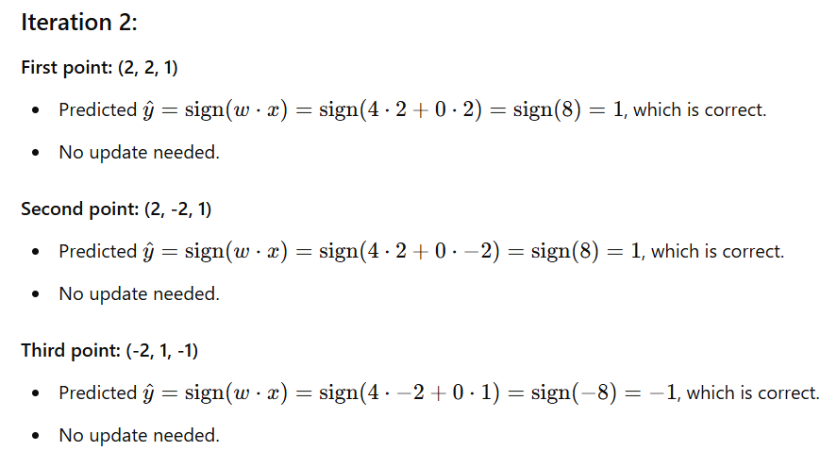
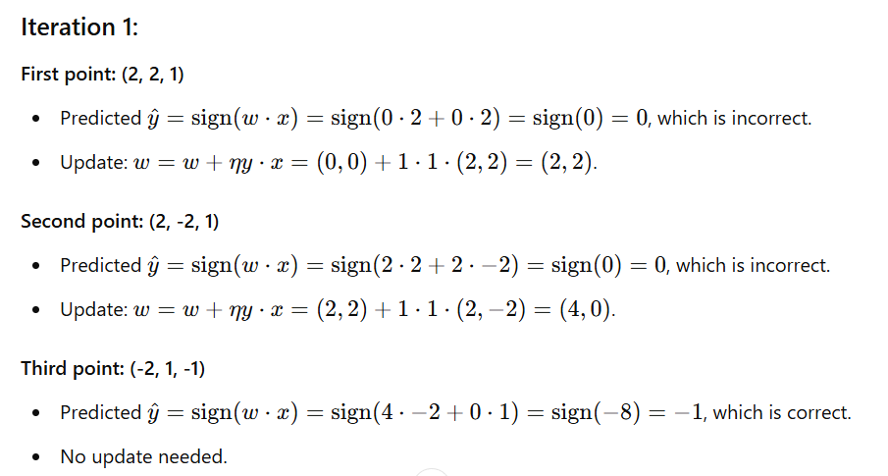
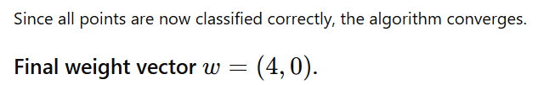
QUESTION 5
SOLUTION 5
CORRECT ANSWER 5
c)

Slide 19
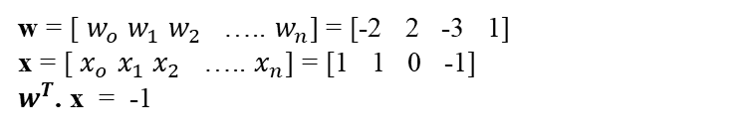
QUESTION 6
What is the output of a perceptron with weight vector w=[2 −3 1] and bias b=−2 when the input is x=[1 0 −1]?
0
1
-1
2
SOLUTION 6
CORRECT ANSWER 6
c)

Slide 20
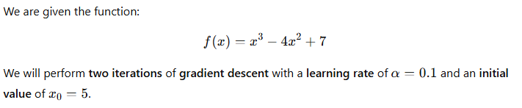
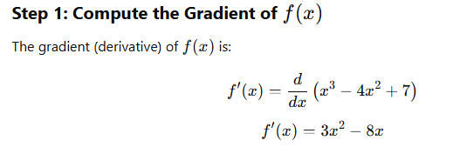
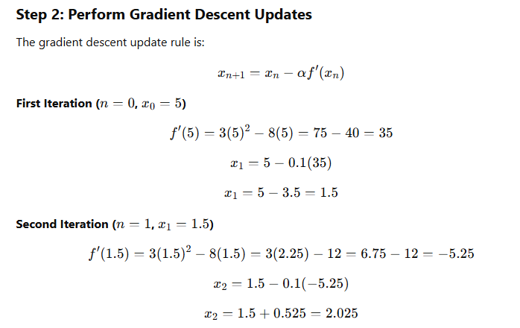

QUESTION 7
SOLUTION 7
CORRECT ANSWER 7
(Type: Range) 2.0,2.1

Slide 21
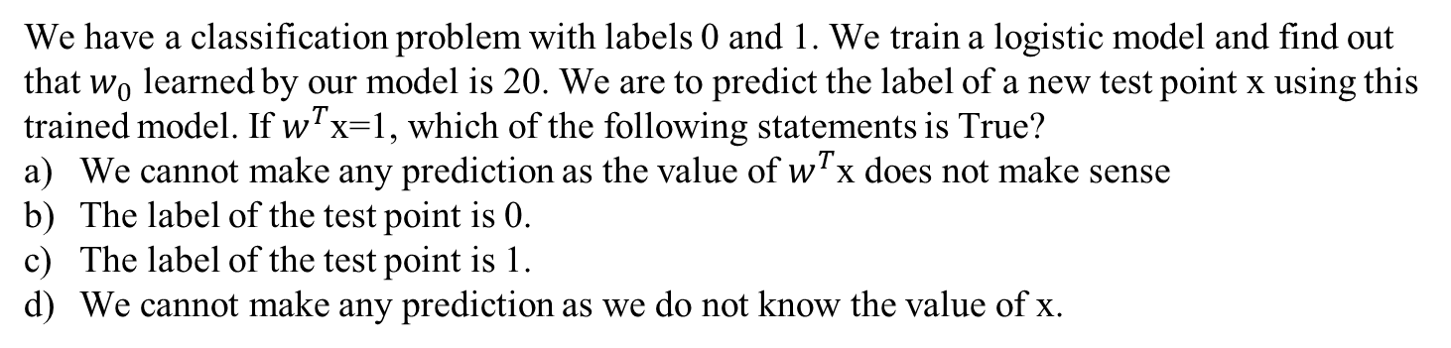
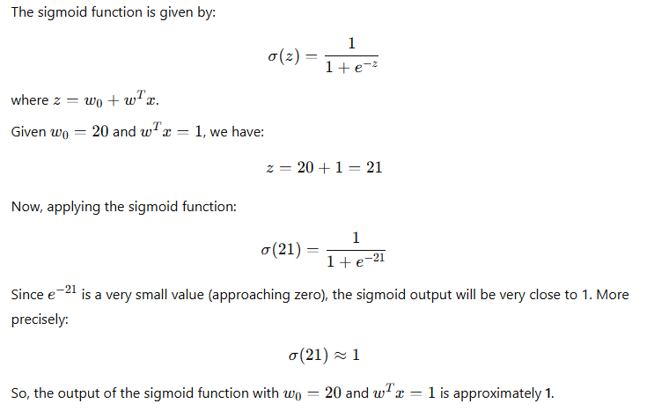
QUESTION 8
SOLUTION 8
CORRECT ANSWER 8
c)

Slide 22

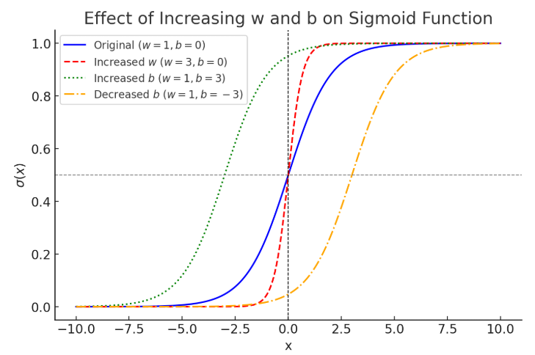
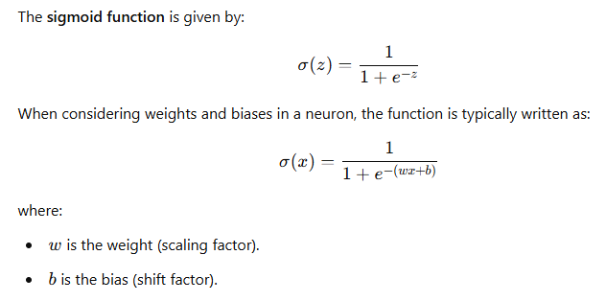
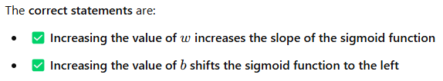
QUESTION 9
Consider the sigmoid function,
where w is a positive value. Select all the correct statements regarding this function.
Increasing the value of w decreases the slope of the sigmoid function
Increasing the value of w increases the slope of the sigmoid function
Increasing the value of b shifts the sigmoid function to the left (i.e., towards negative infinity)
Increasing the value of b shifts the sigmoid function to the right (i.e., towards positive infinity)
SOLUTION 9
CORRECT ANSWER 9
b), c)

Slide 23
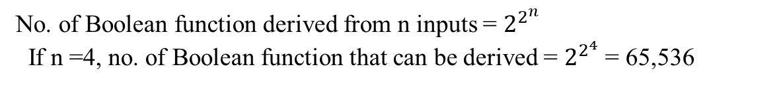
QUESTION 10
How many boolean functions can be designed for 4 inputs?
65,536
8
256
64
SOLUTION 10
CORRECT ANSWER 10
a)

Slide 24
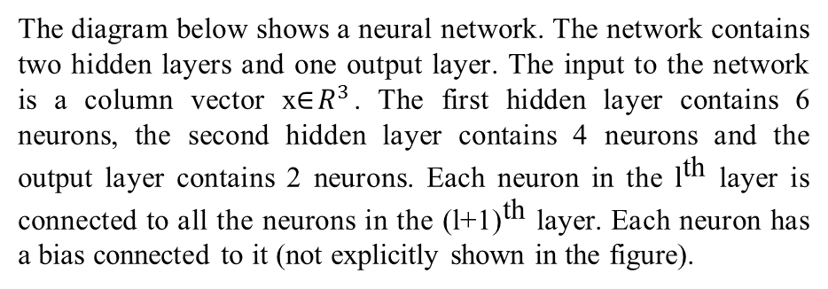
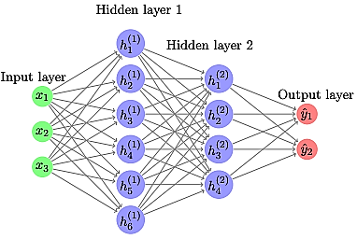
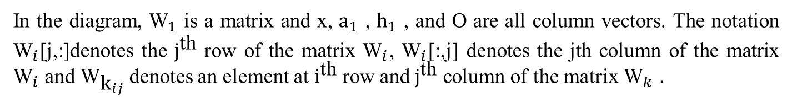
Use the following data to answer the questions 11 & 12

Slide 25
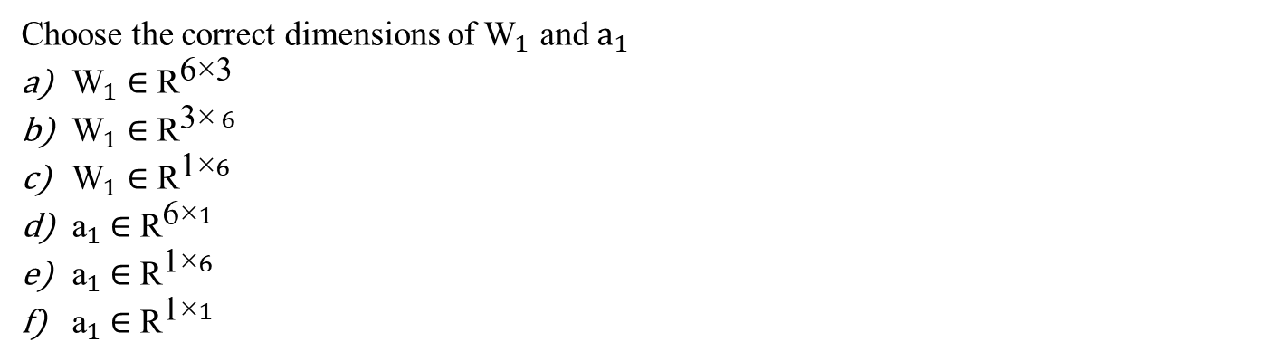
QUESTION 11
SOLUTION 11
CORRECT ANSWER 11
a), d)

Slide 26
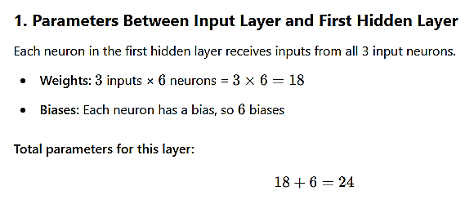
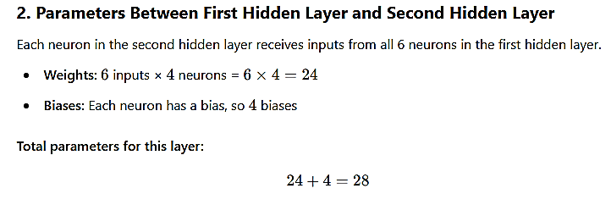
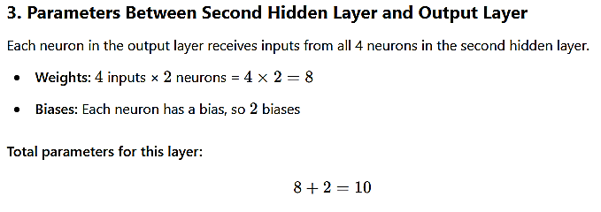
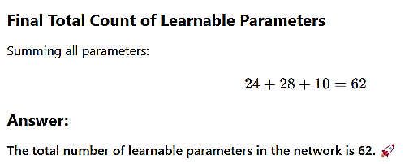
QUESTION 12
How many learnable parameters (including bias) are there in the network?
SOLUTION 12
CORRECT ANSWER 12
62

Slide 27
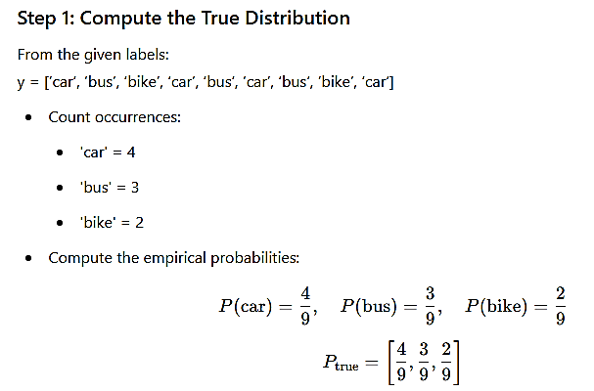
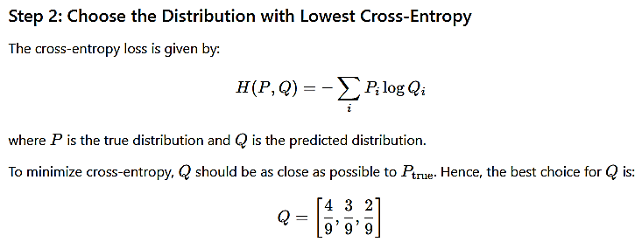

QUESTION 13
We have data x with the following labels y = [‘car’, ‘bus’, ‘bike’, ‘car’, ‘bus’, ‘car’, ‘bus’, ‘bike’, ‘car’]. Which of the following distribution will give the lowest cross-entropy loss with y? (Distribution is given in the following order [‘car’, ‘bus’,‘bike’])?
[0.49,0.30,0.21]
[0.44,0.33,0.22]
[0.50,0.30,0.20]
[0.44,0.39,0.19]
SOLUTION 13
CORRECT ANSWER 13
b)

Slide 28
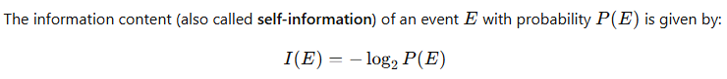
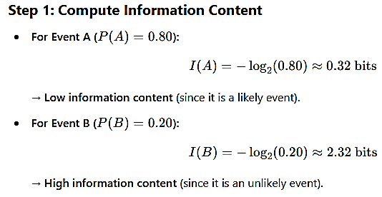
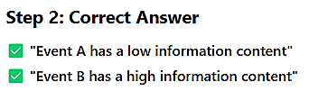
QUESTION 14
Given that the probability of Event A occurring is 0.80 and the probability of Event B occurring is 0.20, which of the following statements is correct?
Event A has a low information content
Event A has a high information content
Event B has a low information content
Event B has a high information content
SOLUTION 14
CORRECT ANSWER 14
a), d)

Slide 29
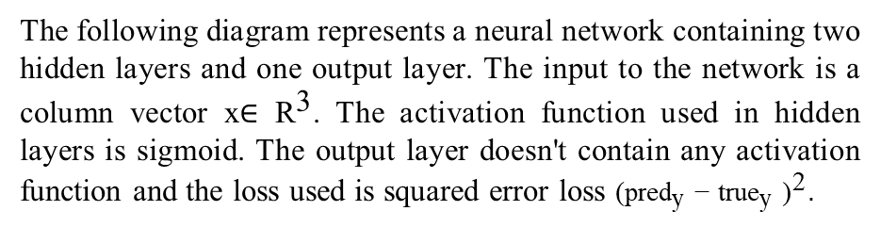
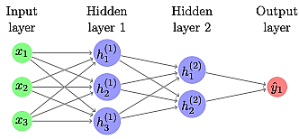
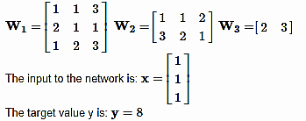
Use the following data to answer the questions 15 and 16
The following network doesn't contain any biases and the weights of the network are given below:

Slide 30
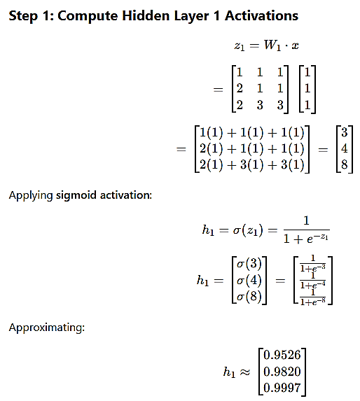
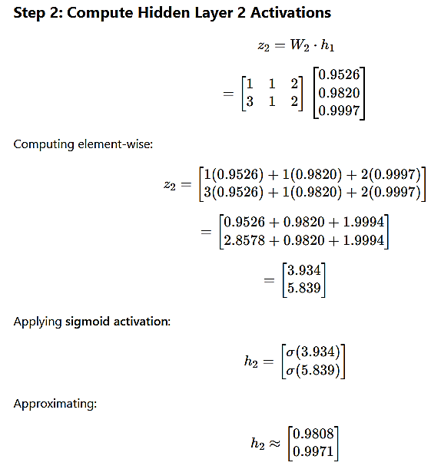
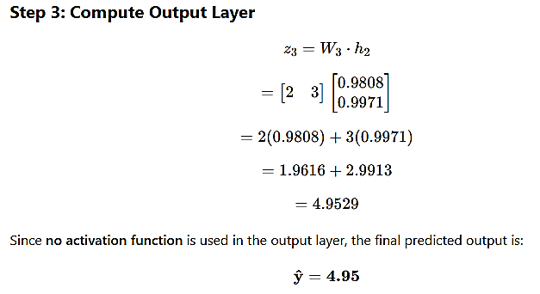
QUESTION 15
What is the predicted output for the given input x after doing the forward pass?
SOLUTION 15
CORRECT ANSWER 15
Range: 4.95 to 4.96

Slide 31
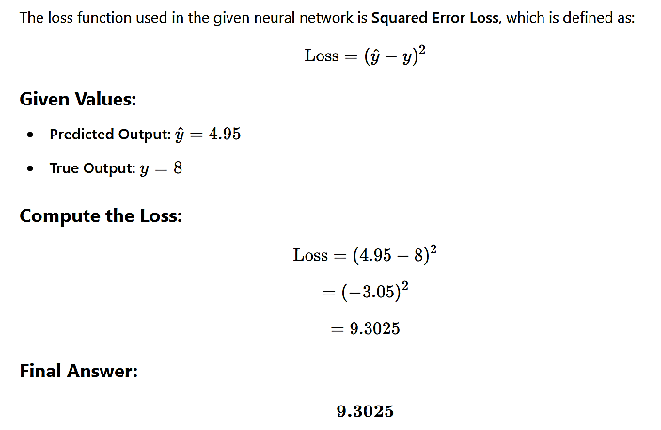
QUESTION 16
Compute and enter the loss between the output generated by input x and the true output y
SOLUTION 16
CORRECT ANSWER 16
Range: 9.30 to 9.31

Slide 32
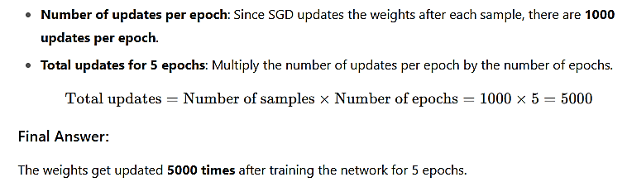
QUESTION 17
A team has a data set that contains 1000 samples for training a feed-forward neural network. Suppose they decided to use stochastic gradient descent algorithm to update the weights. How many times do the weights get updated after training the network for 5 epochs?
1000
5000
100
5
SOLUTION 17
CORRECT ANSWER 17
b)

Slide 33
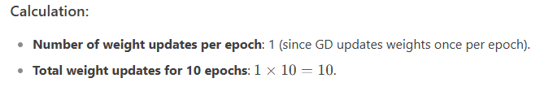
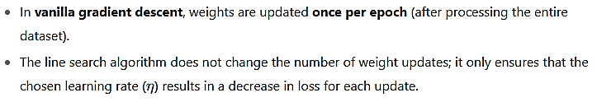

QUESTION 18
A team has a data set that contains 100 samples for training a feed-forward neural network. Suppose they decided to use the gradient descent algorithm to update the weights. Suppose further that they use line search algorithm for the learning rate as follows, η=[0.01,0.1,1,2,10]. How many times do the weights get updated after training the network for 10 epochs? (Note, for each weight update the loss has to decrease)
100
5
500
10
50
SOLUTION 18
CORRECT ANSWER 18
d)

Slide 34
Questions 19-22 are based on common data.

Slide 35


QUESTION 19
SOLUTION 19
CORRECT ANSWER 19
b)

Slide 36




QUESTION 20
SOLUTION 20
CORRECT ANSWER 20
a)

Slide 37






QUESTION 21
The maximum eigenvalue of the covariance matrix C is:
0.33
0.67
1
0.5
SOLUTION 21
CORRECT ANSWER 21
a)

Slide 38




QUESTION 22
SOLUTION 22
CORRECT ANSWER 22
a), d)

Slide 39



QUESTION 23
Which of the following networks represents an autoencoder?
SOLUTION 1
CORRECT ANSWER 23
b)

Slide 40


QUESTION 24
If an under-complete autoencoder has an input layer with a dimension of 7, what could be the possible dimension of the hidden layer?
6
8
0
7
2
SOLUTION 24
CORRECT ANSWER 24
a), e)

Slide 41

Common Data Q25-Q26

Slide 42


QUESTION 25
SOLUTION 25
CORRECT ANSWER 25
b)

Slide 43




QUESTION 26
SOLUTION 26
CORRECT ANSWER 26
a), d)

Slide 44


QUESTION 27
We have observed that the sigmoid neuron has become saturated. What might be the possible output values at this neuron?
0.02
0.5
1
0.97.
SOLUTION 27
CORRECT ANSWER 27
a), d)

Slide 45



QUESTION 28
SOLUTION 28
CORRECT ANSWER 28
0.05

Slide 46




QUESTION 29
SOLUTION 4
CORRECT ANSWER 29
c)

Slide 47




QUESTION 30
SOLUTION 30
CORRECT ANSWER 30
1000

Slide 48




QUESTION 31
You are given the one hot representation of two words below:
CAR=[1,0,0,0,0], BUS=[0,0,0,1,0]
What is the Euclidean distance between CAR and BUS?
SOLUTION 31
CORRECT ANSWER 31
Range: 1.41 to 1.42

Slide 49



QUESTION 32
Consider an input image of size 100×100×1. Suppose that we used kernel of size 3×3, zero padding P=1 and stride value S=3. What will be the output dimension?
SOLUTION 32
CORRECT ANSWER 32
34

Slide 50

QUESTION 33
Consider an input image of size 100×100×3. Suppose that we use 10 kernels (filters) each of size 1×1, zero padding P=1 and stride value S=2. How many parameters are there? (assume no bias terms)
5
10
15
30
SOLUTION 33
CORRECT ANSWER 33
d)

Slide 51

QUESTION 34
Which of the following architectures has the highest no. of layers?
AlexNet
GoogleNet
ResNet
VGG
SOLUTION 34
CORRECT ANSWER 34
c)

Slide 52



QUESTION 35
SOLUTION 35
CORRECT ANSWER 35
7600

Slide 53




QUESTION 36
SOLUTION 36
CORRECT ANSWER 36
a)

Slide 54


QUESTION 37
SOLUTION 37
CORRECT ANSWER 37
d)

Slide 55


QUESTION 38
Which scenarios would most benefit from hierarchical attention mechanisms?
Summarizing long text documents
Classifying images in a dataset
Analyzing customer reviews or feedback data
Real-time processing of sensor data
SOLUTION 38
CORRECT ANSWER 38
a)

Slide 56

QUESTION 39
Which of the following output functions is most commonly used in the decoder of an encoder-decoder model for translation tasks?
Sigmoid
ReLU
Softmax
Tanh
SOLUTION 39
CORRECT ANSWER 39
c)

Slide 57


QUESTION 40
If we make the vocabulary for an encoder-decoder model using the given sentence. What will be the size of our vocabulary?
Sentence: Convolutional neural networks excel at recognizing patterns and features within images, enhancing object detection accuracy significantly.
13
18
14
16
SOLUTION 40
CORRECT ANSWER 40
d)

Slide 58


Contact me: https://sites.google.com/view/ayans-agribot/home

